Slide 1
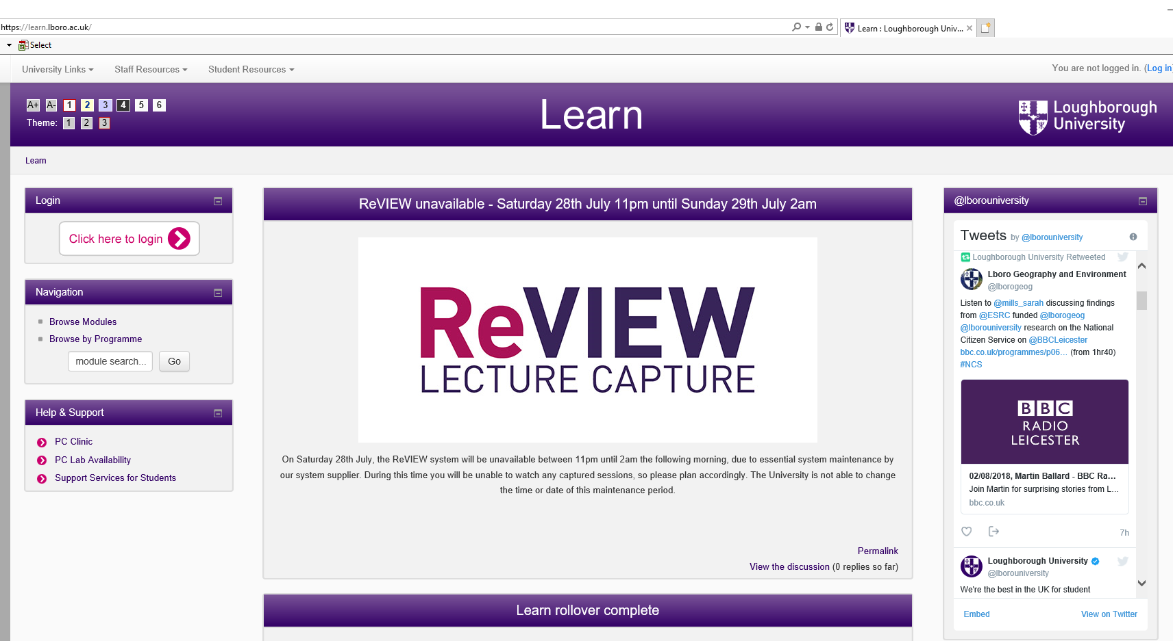
Protect Loughborough’s Intellectual Property
All lecture slides, worksheets and reading lists available from Learn are the property of Loughborough University. Please do not share them externally or upload them onto external websites.
Notes:
Help new students to understand that the materials provided on Learn by their lecturers are the property of the university. This includes, lecture slides, worksheets, past exam papers, reading lists and other relevant documents. They should not be uploaded onto external websites as this is a breach of the IT AUP and is a disciplinary matter.

